Slide 1
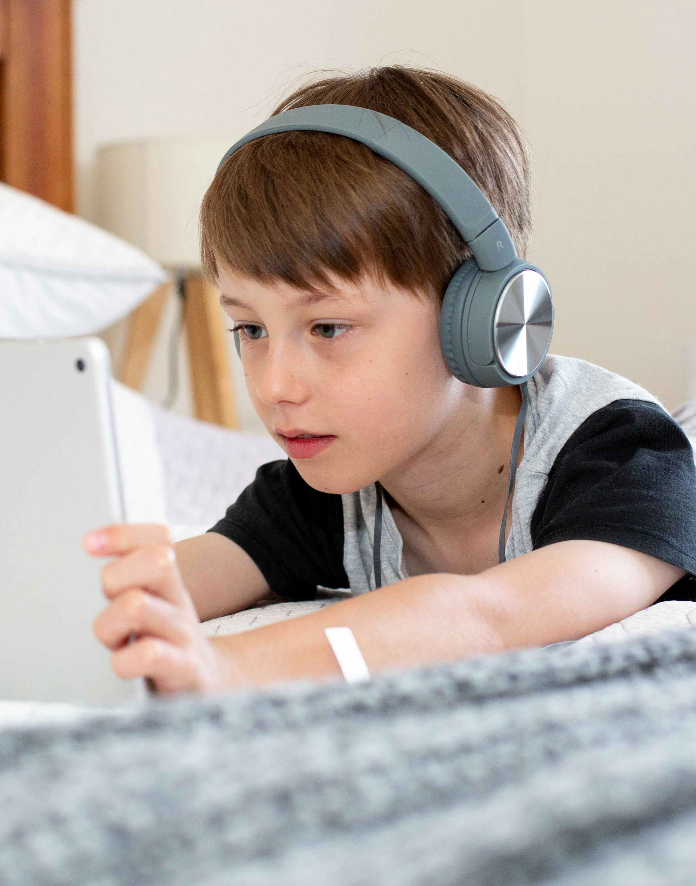

MR-PROTECT
Forget old school adult website blockers; protect your whole operating
system with high tech AI online and offline.

Slide 2
OVERVIEW
About Team
03
Introduction
04
Problem
05
Solution
06
Product
09
Pricing Plan
10
Market Size
1 1
Market Validation
12
Competitors
13
SWOT Analysis
14
Timeline
15
Press
16

Slide 3

MR-PROTECT TEAM
E
Emre Günaydin
CEO/Developer
Career:
-Studied Electrical and Electronics Engineering
-Currently Test Agent (Team Leader) of a Test Automation Team in Siemens AG
-17 Years Software Development/Test Experience
-9 Years Team Leader Experience
-Languages: German, Turkish, English
Hobbies:
-Professional Guitarist and Vocalist
(Several Gigs per Year Facebook/Morgenemre)
-Fitness

Slide 4

INTRODUCTION
MR-PROTECT is an AI based parental control app, fills a big gap in parental control app market with its four unique high-tech solutions, which do not exist on any parental control app in the world.

Slide 5

Problem
Parental Control App
Market Pain Problems
Blocking webcam sex and the recording of nude
videos is impossible.
Adult content blocking just available for web browsers
Offline solution does not exist
Active VPN Cancellation does not exit

Slide 6

AI Adult Content Screen Blocking
Shutting down apps automatically, which contain explicit content on the screen independent of app type (video players, emails, USB sticks, computer games etc.)
Solutions
AI Webcam Adult Content Monitoring/Blocking
Shutting down webcam apps automatically and sending notifications to parents, if any explicit content is detected on the camera.
Parents install Mr-Protect on
their children’s devices (laptop, smartphone, …). The app
runs in the background and
provides four unique
solutions.
Offline Protection
Blocking all explicit images in online and offline mode of device.
VPN Cancellation
Detecting active VPN application on protected device and blocking against website blocking bypass.

Slide 7



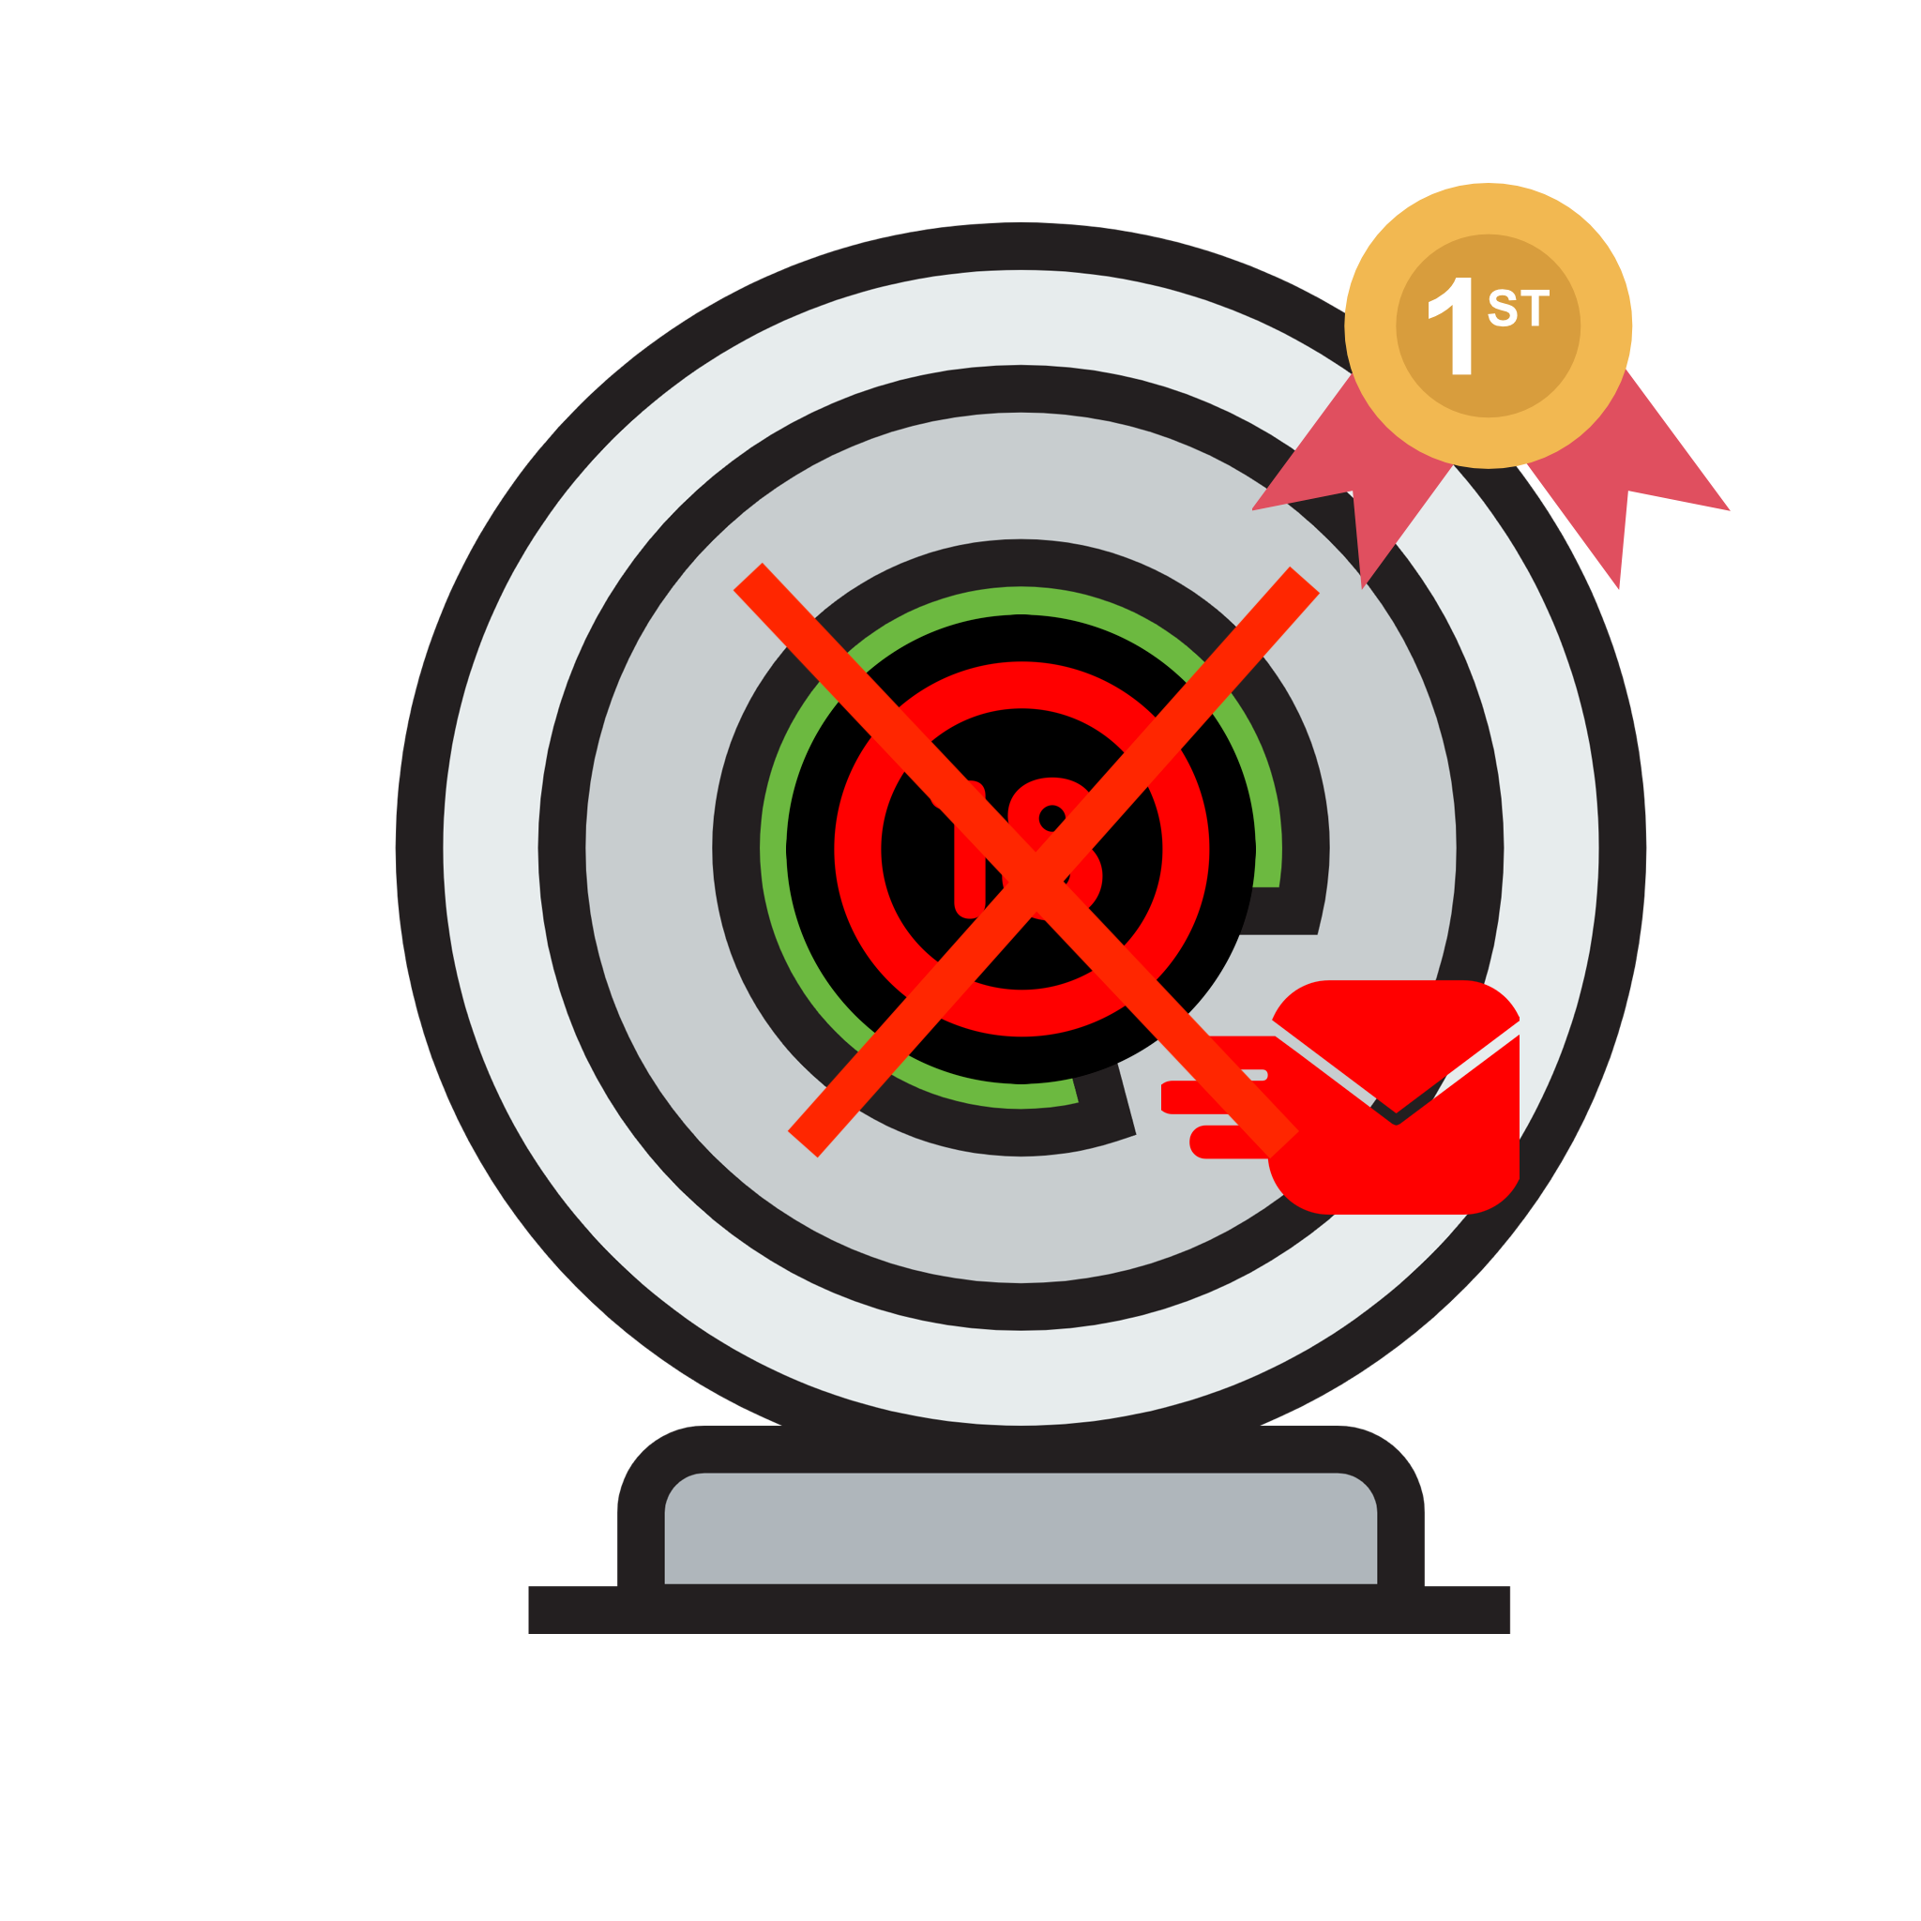

Solutions in detail (4 Important Feat.)
AI Adult Content Screen Blocking
(First and only in the world)
AI Adult Content Webcam Monitoring/ Blocking
(First and only in the world)
VPN Canceller
(First and only in the world)
Offline Protection
(First and only in the world)
1-Monitors VPN configuration periodically.
2-If any active installed VPN app is detected, then closes the internet connection automatically and keeps
the device offline till
VPN is disabled by the user.
Demo:
1-Monitors the webcam locally whenever it is activated.
2-AI tech processes the monitored data
at the background.
3-Automatically closes the webcam app if nudity is detected.
Demo:
1- AI tech does not require any external server; it works locally on protected device.
2-Protection is not only
restricted with web browser but
also, all interfaces (webcam
apps, video players, emails,
computer games etc.).
Demo:
1- Monitors screen locally.
2-AI tech processes the
monitored data
at the background.
3-Automatically closes any open apps
(Insta, Mail, Face.),
if any adult content detected.
Demo:
Link
Link
Link
Link

Slide 8
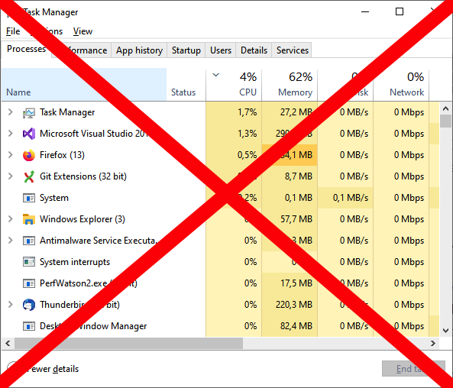










Other Features
Solutions in detail (Other Feat.)
Task Manager Blocking
Notifications
Photo Encryption/Blurring
AI Disk Scan
Disables task manager in Windows.
SMS(Not released yet.), Email, menubar/status bar badge(on protected device) and alerts(on protected device).
Blurring and encryption options for detected and saved photos with adult content on local PC.
Scans photos for explicit images on the entire hard drive and sends a report.
Demo:
-
Demo:
-
Demo:
Demo:
Link
Link
Weekly/ Daily Report
Proof of Protection
DNS Hijack Protection
Shut Down Protection
Reports the selected AI webcam, screen or disk scan activities daily or weekly.
At least one screenshot image (no matter Includes explicit content or not) from protected device attached to reporting.
Protects DNS settings(Used for website blocking) of protected device against manipulations.
Prevents the application from being closed by anyone even via task manager or activity monitor.
Demo:
-
Demo:
-
Demo:
Demo:
Link
Link
Local Processing
Scheduler
Wesite Blocking
The entire process and analysis occur just locally on your children`s devices.
Parents can schedule the execution time and blocking/monitoring mode according to their needs.
Blocks millions of adult websites, enables Safe Mode for Google, Bing and Youtube and more …
Demo:
-
Demo:
Demo:
Link
Link

Slide 9
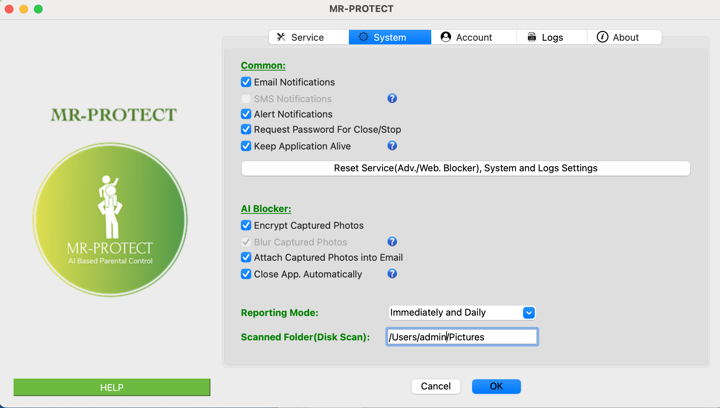
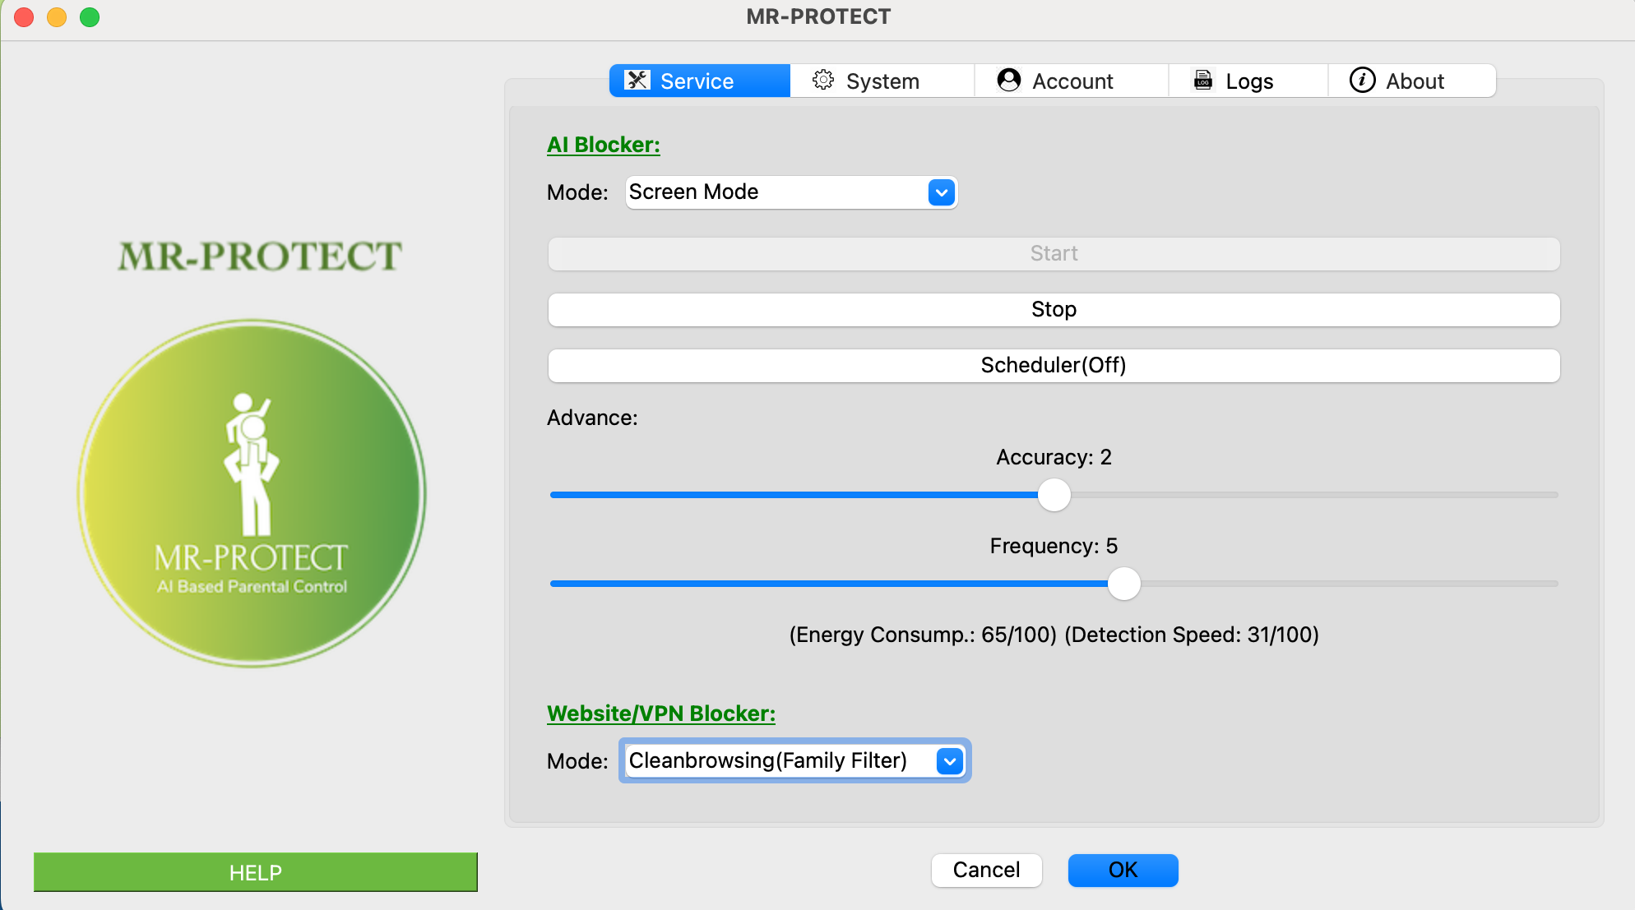
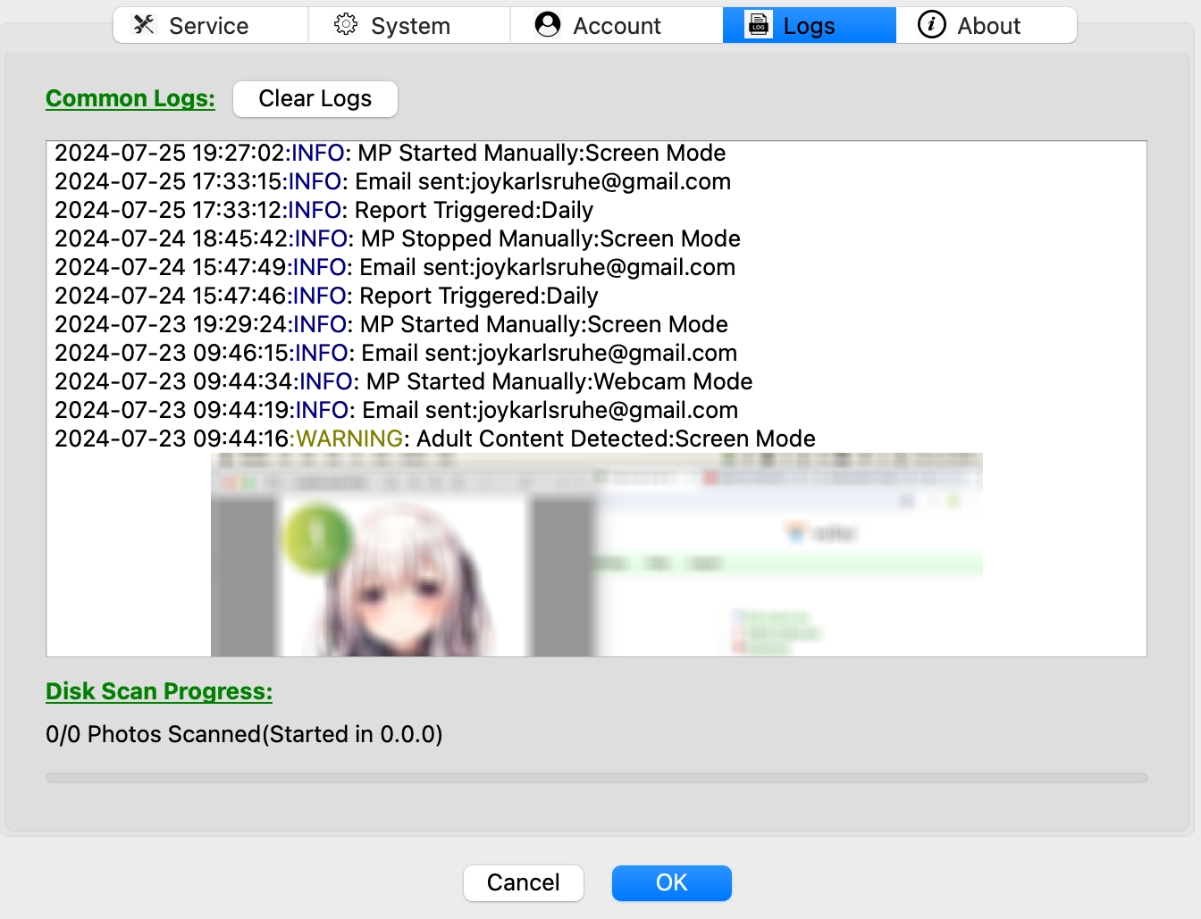
Product
Product (Some screenshots of GUI)

Slide 10


Pricing Plan
KI-Premium Model:
Premium Model:
AI-Screen Monitoring/Blocking
AI-Web. Monitoring/Blocking
AI- Disk Scan
Offline Protection
VPN Canceller
Web Filtering
Time Limit
Allow/Block App
App Alerts
Monitoring
Platforms: Android, IOS, Mac & Windows
VPN Canceller
Web Filtering
Time Limit
Allow/Block App
App Alerts
Monitoring
Platforms: Android, IOS, Mac & Windows
AI-Screen Monitoring/Blocking
AI-Web. Monitoring/Blocking
AI- Disk Scan
Offline Protection
VPN Canceller
Web Filtering
Time Limit
Allow/Block App
App Alerts
Monitoring
Platforms: Android, IOS, Mac & Windows
List your features
List your features
List your features
Basic Plan(5 Dev):
4,99/Mo 49,99/Ann
Family Plan(10 Dev):
7,99/Mo 79,99/Ann
Basic Plan(5 Dev):
3,99/Mo 39,95/Ann
Family Plan(10 Dev):
6,99/Mo 69,99/Ann
Basic Plan(1 Dev):
€0/(5 Days)

Slide 11
Market Size
Market Size
2023: Global Parental Control Software Market Value: €1.25 Billion
2032: The projections are that it will reach a market value of €3.54 billion
73%
62%
parents in UK protect their kids by parental control apps
In first of half of 2021, 62% more confirmed reports of sextortion criminal content than in 2020
81%
257%
parents in America protect their kids by parental control apps
In first of half of 2023, 257% more confirmed reports of sextortion criminal content than in 2022
41%
of French 15-, 16- and 17-year-olds visit dedicated pornographic sites (2022)

Slide 12


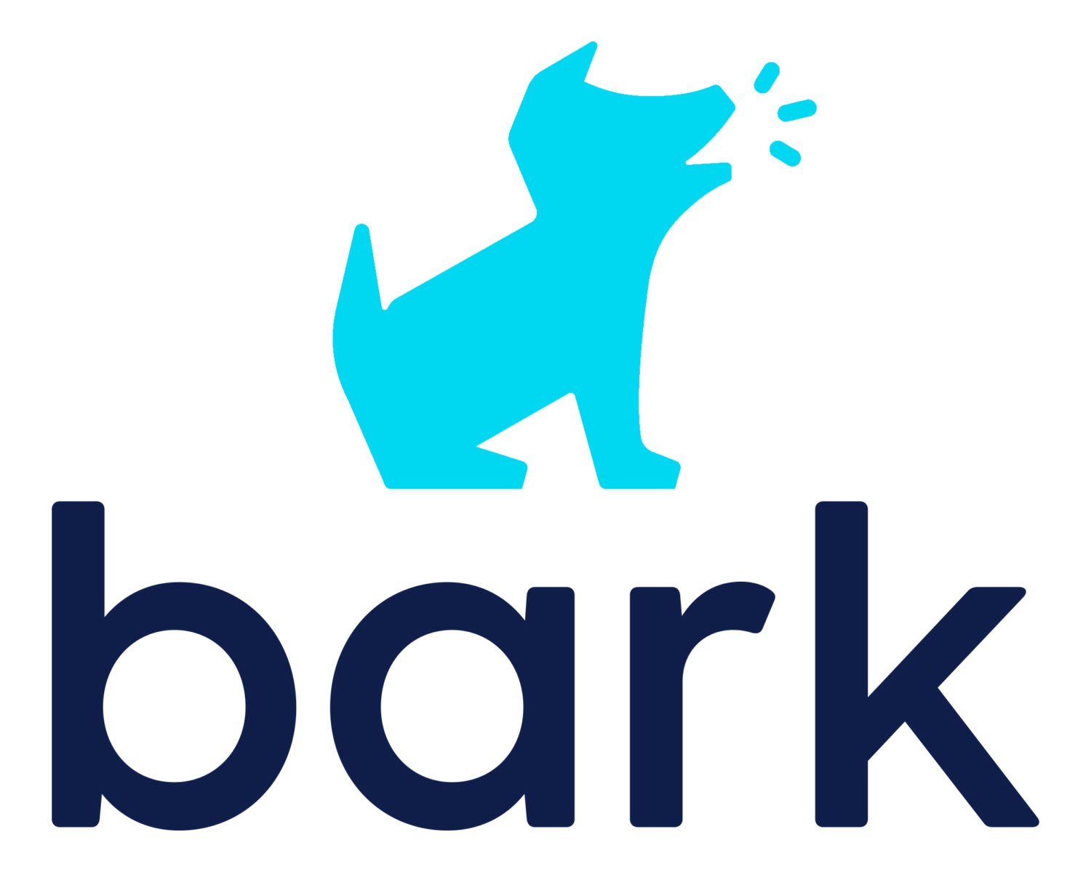

Market Validation
Some of Market Leader Revenues and Users
Revenue: ~ €23 M
Users: 2 M
Revenue: ~ €10 M
Users: 2 M
Revenue(2021): ~ €1.6 M
Users: -

Slide 13
Competitors
 | Price | Webcam Adult Cont. Monitoring | Webcam Adult Cont. Blocking | Screen Adult Cont. Monitoring | Screen Adult Cont. Blocking | VPN Canceller | Adult Content Disk Scan | Offline Protection | App Blocking | Time Limit | Web Filtering | Location Tracking | Text, Social Media Monitoring | Removal Protection
Mr-Protect (M,W) | €49,99/yr
Covenant Eye (M,W,A,I) | €168,95/yr
Canopy (M,W,A,I) | €91,23/yr
Bark App (M,W,A,I) | €91,23/yr
Qustodio (M,W,A,I) | €75,95/yr
Norton Fam. (M,W,A,I) | €44,99/yr
WEBCAM ADULT CONTENT MONITORING / BLOCKING: Monitoring and blocking are only available for photo shooting, not for sex or video content.
TEXT AND SOCIAL MEDIA MONITORING: Only text monitoring is supported.
SCREEN ADULT CONTENT MONITORING: Monitoring is limited to certain specific apps and is very restricted in scope.
VPN-CANCELLER: Either installed VPN apps or browser-based VPN apps can be blocked, but not both simultaneously.
REMOVAL PROTECTION: If daily reporting feature is enabled, then the parents can detect whether the app has been removed or not.
M:MacOS W:Windows A:Android I:IOS

Slide 14
SWOT Analysis
Four Game Changer Unique Features
The Lowest Price in AI Based Competitors
Development and Test Background
Of Founder
IOS and Android(in 4M will be released) Unsupported Yet
One Man Show Till Now
No Money Resource Available (Investor required)
S
W
A Hugh Market
With Increasing Interest in Social Media, the Demand for Parental Control Apps is Increasing
0
T
Competitors can Implement The Same Features(Patent Required)

Slide 15
Timeline
Timeline
Development of Time Limit, Allow/Block App, App Alerts, and Monitoring
Finding two Partners with Software Developer and Business Administrator Background
First Release of IOS Version
Hiring a Fulltime Developer
Q3/2025
Q4/2025
Q1/2027
Q2/2028
2
Q4/2025
Q2/2026
Q4/2027
Finding an Investor
And Applying
for Patent
First Release of Android Version (Proof of Concept Already Completed)
Improvements for Object Detection Model (Text and Violation/Gamble Image Detections)

Slide 16





56%
The ASK
Recruitment
17%
Marketing & Growth
I am seeking a seed investment of €600,000 in exchange for 10% equity in the company.
13%
Office & Operating Expenses
10%
Founding Costs
4%
Product Development

Slide 17
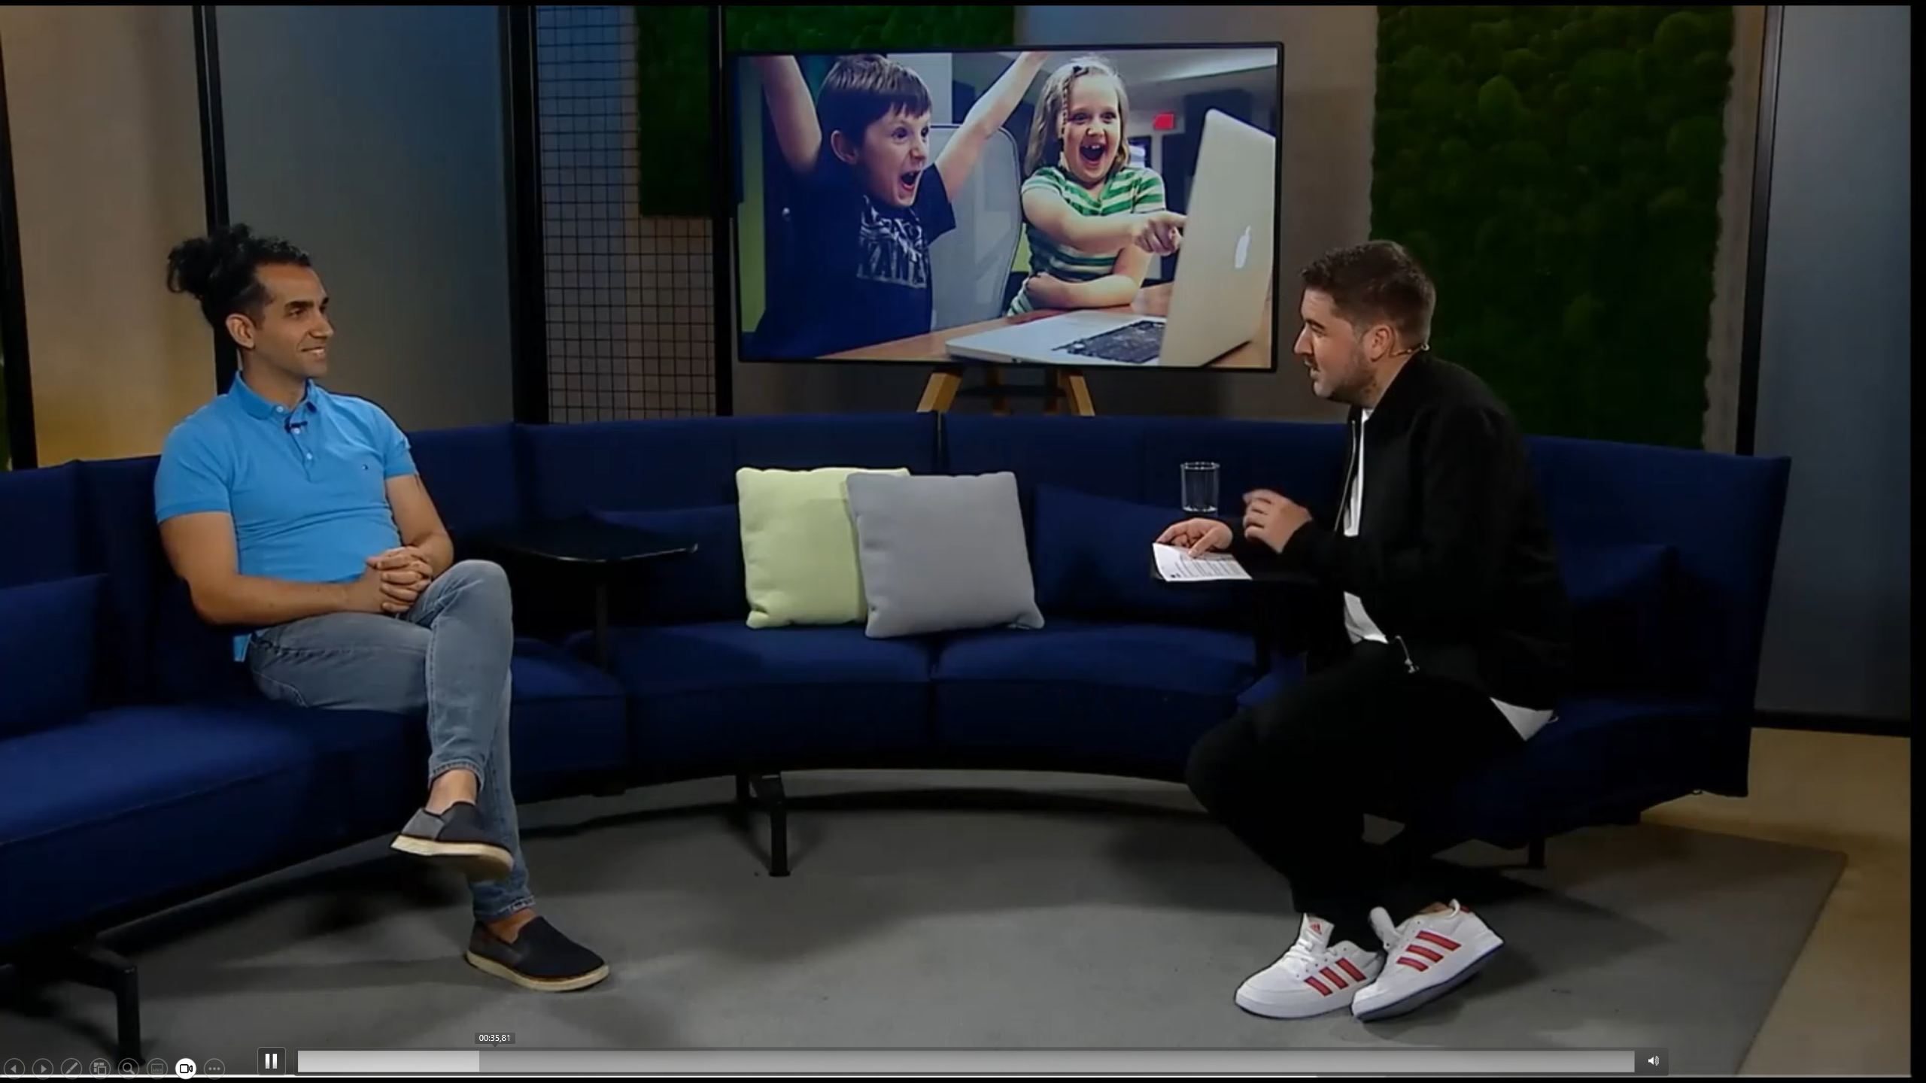
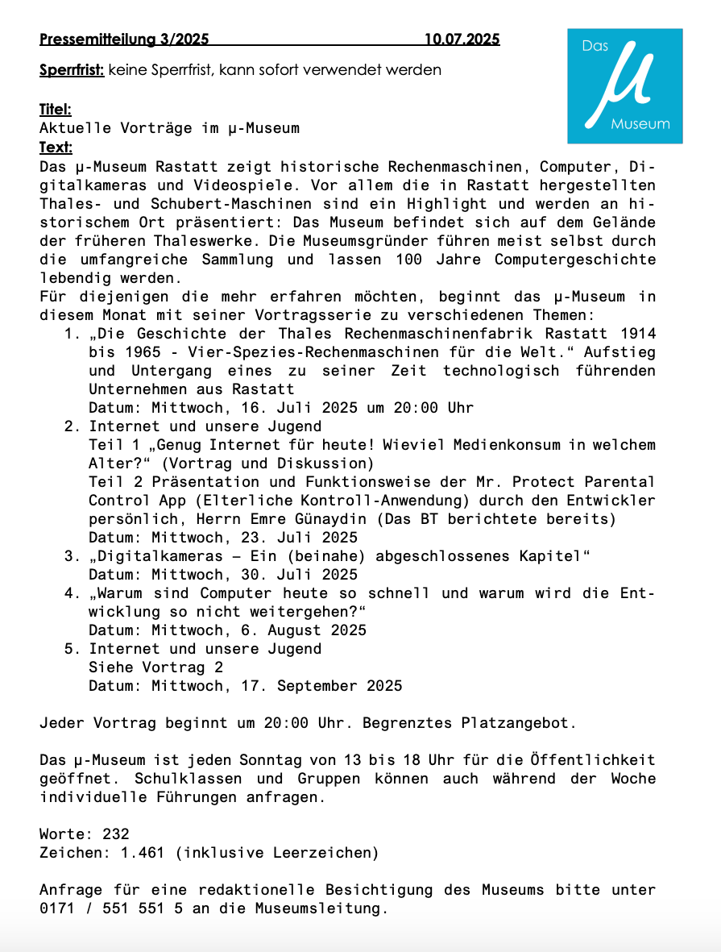
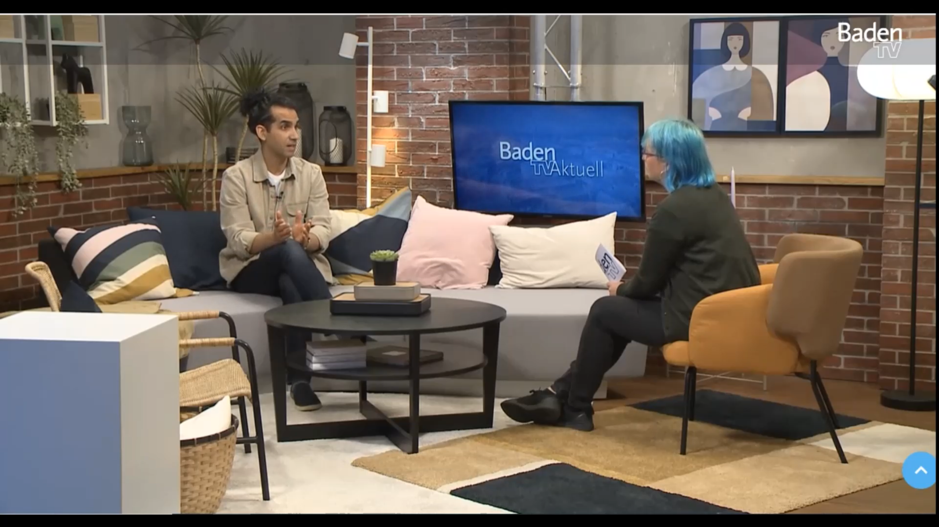
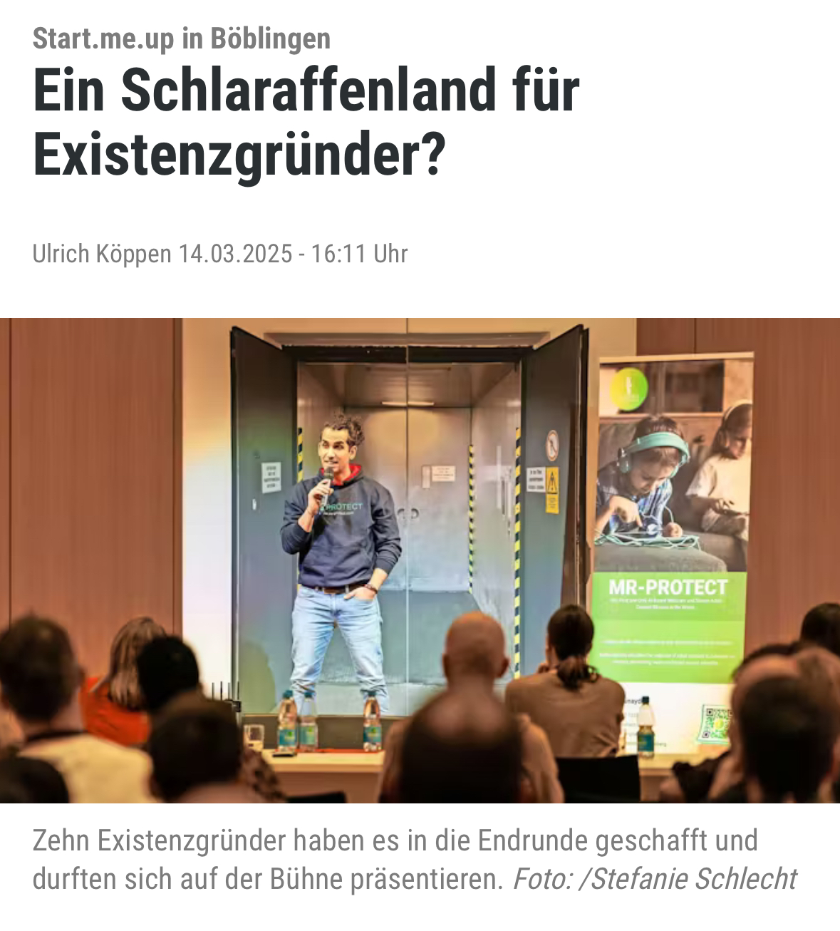
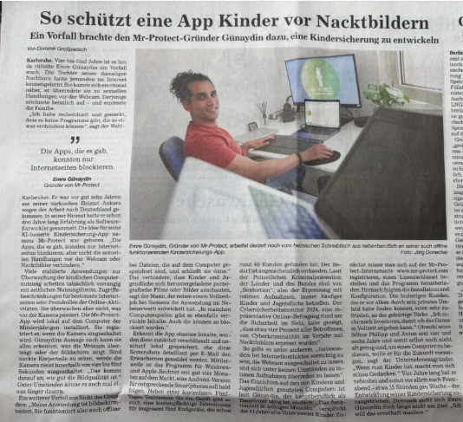
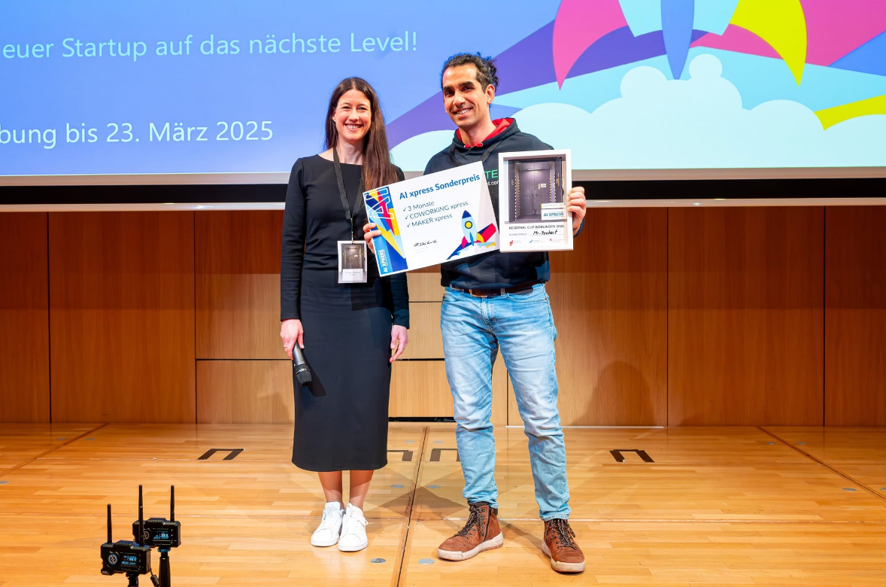
Press
Mr-Protect Presentation
at the U-Museum Rastatt
(17.09.2025)
RNF TV (06.08.2024)
Baden TV (27.05.2024)
Link (20. Min)
Link
Link (10. Min)
Kreiszeitung Böblinger Bote
(06.08.2024)
BBN
(01.07.2025)
AI Xpress Special Prize BW Elevator Pitch Regional Cup
(14.03.2025)
Link
Link
Link

Slide 18
THANKS!
Do you have any questions?
support@mr-protect.com
+49 157 735 26 406
https//mr-protect.com

